Slide 1
Touch For Food January 15 Meeting
CloudNine

Slide 2
Agenda
Retrospective on last few sprints
Recap of meeting with Dr. Constantinides
Stakeholder update (Pat and Mat)
Review of what's left (stories, defects, and doc)
1 minute per defect for the reporting person to explain the defect

Slide 3
Agenda
Schedule, deadlines and goals
Demos
Code reviews with branches (Ryan)
Unit testing (Mike)

Slide 4
Agenda
General Issues
Database backup, restore and test data
Email/Google group chains
Finders and mappers
File/folder cleanup?
Db in memory issue
Commit issues
Coding standards
Exception class for non-active menu
Deleting a menu_item that is associated to an order
Scrum update from each team member
Questions and comments

Slide 5
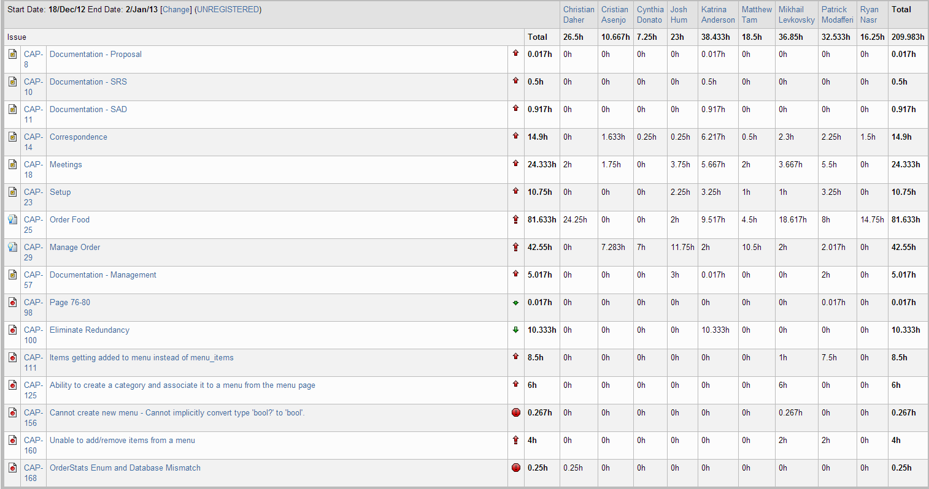
Retrospective – Sprint 4

Slide 6
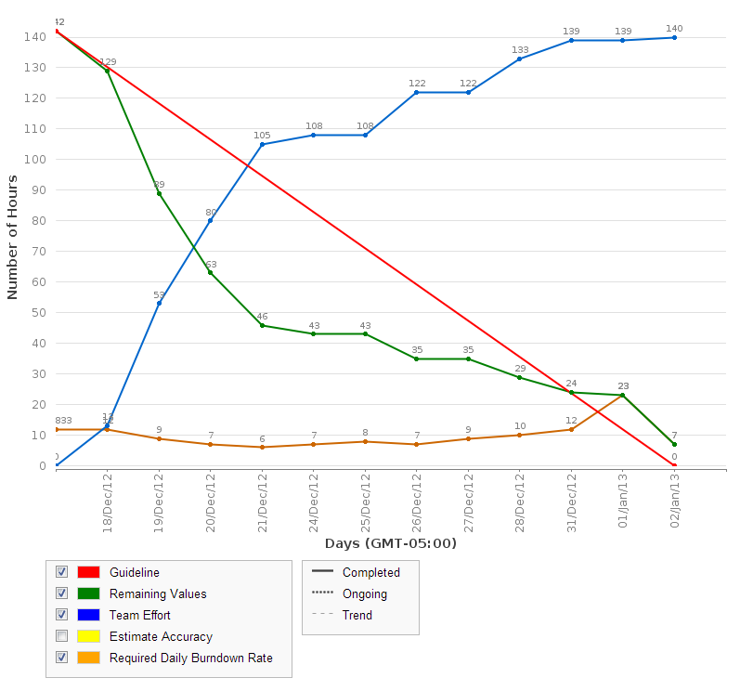
Retrospective – Sprint 4

Slide 7
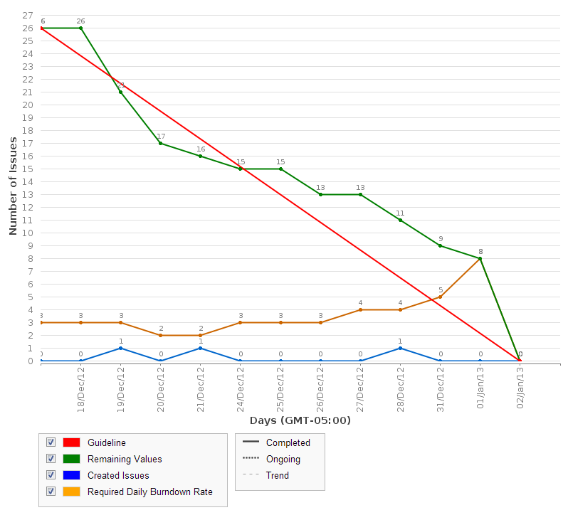
Retrospective – Sprint 4

Slide 8
Retrospective – Sprint 4
Sprint 4 velocity (story points): 18 story points
Cumulative velocity (story points): 31 story points
Average velocity (story points): 7.75 story points
Sprint 4 velocity (p-h): 124.2 person-hours
Cumulative velocity (p-h): 222.2 person-hours
Average velocity per sprint: 55.6 person-hours

Slide 9
Retrospective – Sprint 4
Total person-hours budgeted to date: 2,898 ph
Total person-hours worked: 516.705 ph
Person-hours budgeted per sprint: 414 ph
Person-hours worked in Sprint 4: 209.98 ph

Slide 10
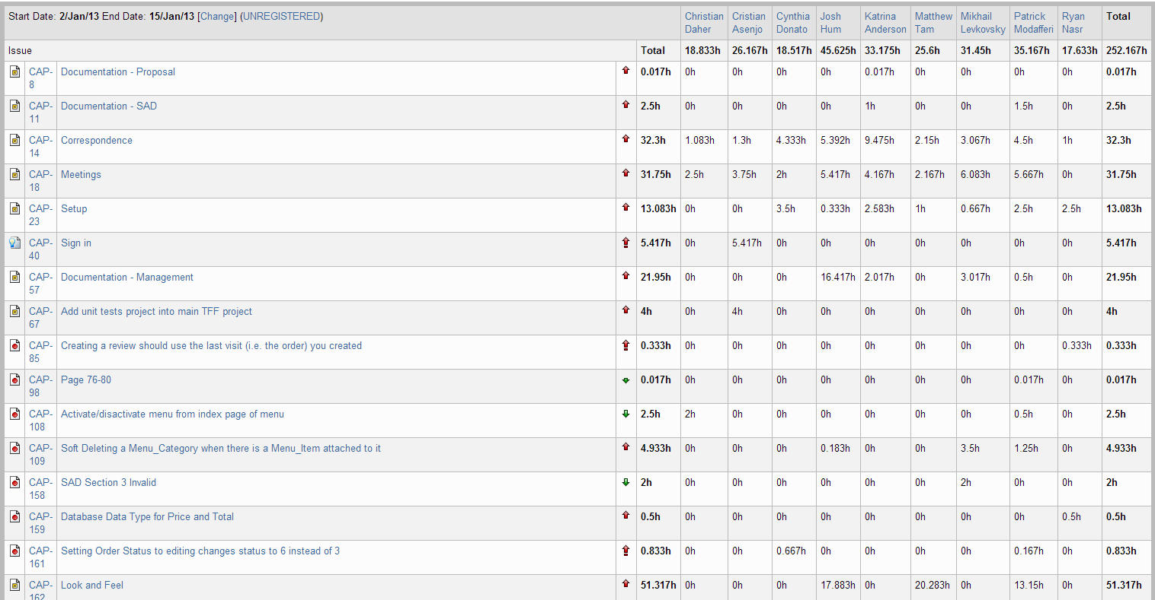
Retrospective – Sprint 5

Slide 11
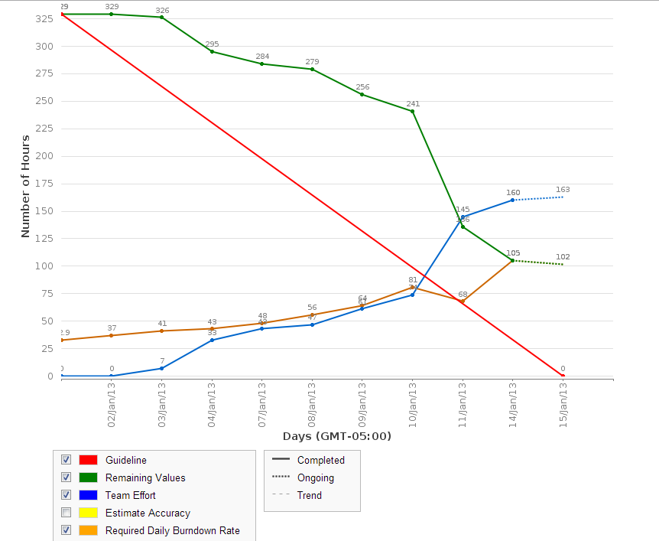
Retrospective – Sprint 5

Slide 12
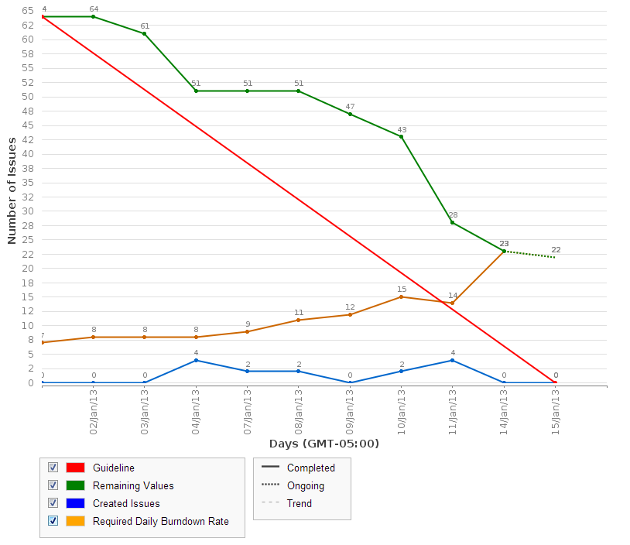
Retrospective – Sprint 5

Slide 13
Retrospective – Sprint 5
Sprint 5 velocity (story points): ?? story points
6 story points for Sign In and Manage Tables
Cumulative velocity (story points): 31 story points
Average velocity (story points): ?? story points
If completed, average would be 7.7 story points
Sprint 5 velocity (p-h): 24.25 person-hours
Cumulative velocity (p-h): 246.5 person-hours
Average velocity per sprint: 49.3 person-hours

Slide 14
Retrospective – Sprint 5
Total person-hours budgeted to date: 3,312 ph
Total person-hours worked: 769 ph
Person-hours budgeted per sprint: 414 ph
Person-hours worked in Sprint 5: 252 ph

Slide 15
Retrospective – Sprint 5
Look and Feel
Sign In
Manage Tables

Slide 16
Meeting Recap w/ Dr. Constantinides

Slide 17
Stakeholder Update
Dr. Grogono

Slide 18
Scrum update
2 minutes each

Slide 19
What’s left
Backlog

Slide 20
UIR
Review parts
Assign parts

Slide 21
UI Testing
Review parts
Assign parts

Slide 22
Goals
Scoping out social aspect
Todo:
Call waiter
Customer Bill Management
Toppings and Sides
Implement discussed patterns
Fix flow, ensure all closed stories work the way they should (data validation, etc.)
Android mobile wrapper (iPhone if there is time)
Discuss the rest

Slide 23
Schedule
Sprint 6
Review each story, fix flow
Implement patterns (Mapper, Finder)
UIR
Bugs & QA
Call waiter
Bill Management
View Menu
Sprint 7
Toppings and sides
Bugs
SAD
Update docs to hand in

Slide 24
Schedule
Sprint 8
Android wrapper
NFC & QR Code
Bugs
Other features TBD

Slide 25
Code Review Demo

Slide 26
Unit Testing Demo

Slide 27
General Issues
Database backup, restore and test data
Make sure that after you backup, try to restore on your machine and if possible, send it to one person to test before commit
Cristian demos .bak
Chris demos .sql

Slide 28
General Issues
Process on closing bugs
Reporting person reviews it
If the reporting person is working on it, someone who has a good understanding of the bug should review it

Slide 29
General Issues
Email/Google group chains
Finder and mappers
File/folder cleanup
Db in memory issue

Slide 30
General Issues
Commit standards
Make sure you test db .bak and .sql
Run the application and test to make sure nothing broke
If after updating, files are missing, show all files and include them
Probably less of an issue if branches are being used
Don’t commit web.config or any other useless files

Slide 31
General Issues
Create bug to fix coding standards
Exception class for non-active menu (Mike)
Deleting a menu_item that is associated to an order (Mike)

Slide 32
Questions?

